Slide 1
Detection of Brain Tumor using Convolution Neural Networks
Group – 38
Nithish Reddy Emmadi - 0754724
Venkata Kalyan Ram Ghatti - 0756328
Priya Kandula – 0754438
Venkata Hanuman Sai Kumar Kaparaju - 0753837
Harish Veeramosu - 0755976

Slide 2
Introduction
Brain tumor is one of the most dangerous diseases which require early and accurate detection methods. Brain Tumor Detection is one of the most difficult tasks in the field of medical image processing.
Now most detection and diagnosis methods depend on decision of neuro-specialists, and radiologist for image evaluation which may lead to possible human errors and time consuming.

Slide 3
Objectives
To automate the brain tumor detection using the Convolutional neural networks(CNN).
To implement the deeper architecture using the small kernels.
To achieve maximum accuracy with minimum complexity when compared with other traditional methods.
To overcome the problem of accurate quantitative measurements for large amount of MRI images.

Slide 4
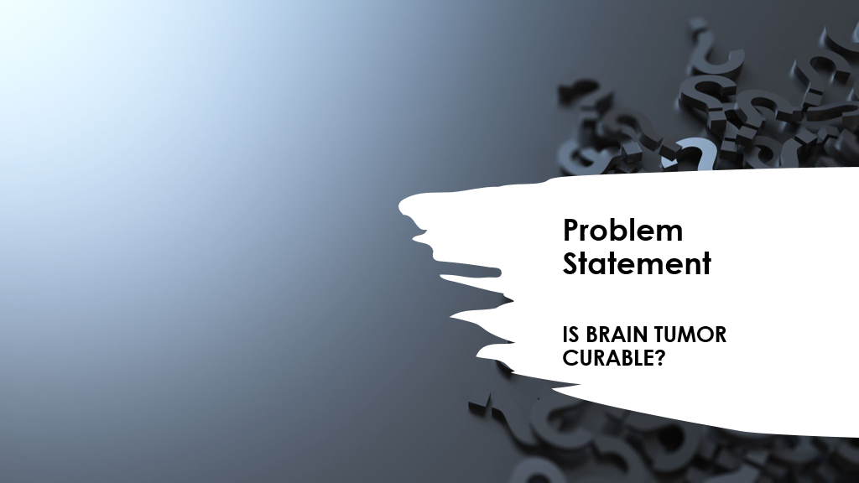

Slide 5
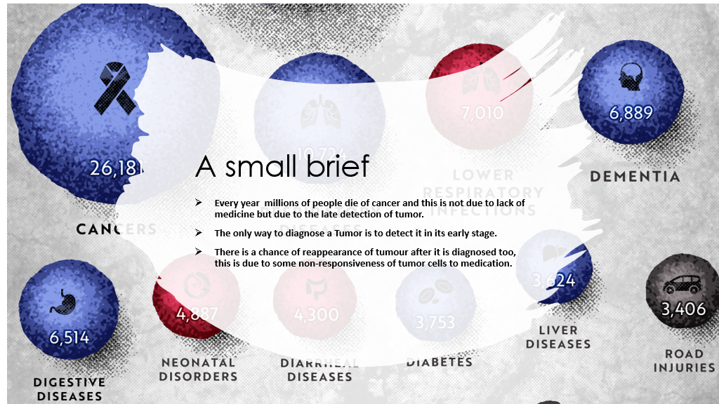

Slide 6
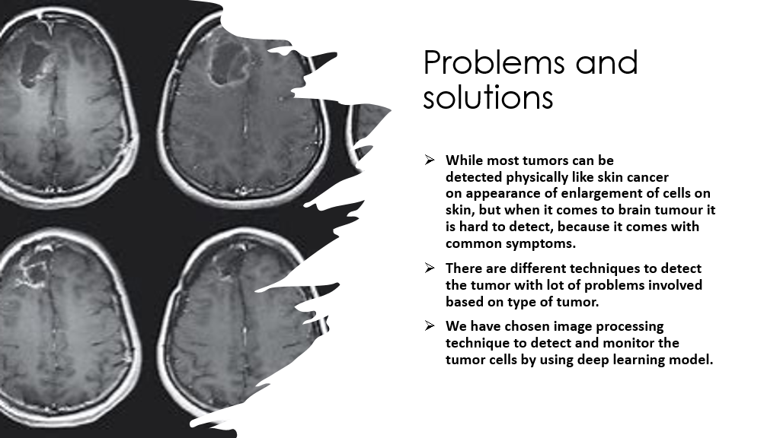

Slide 7
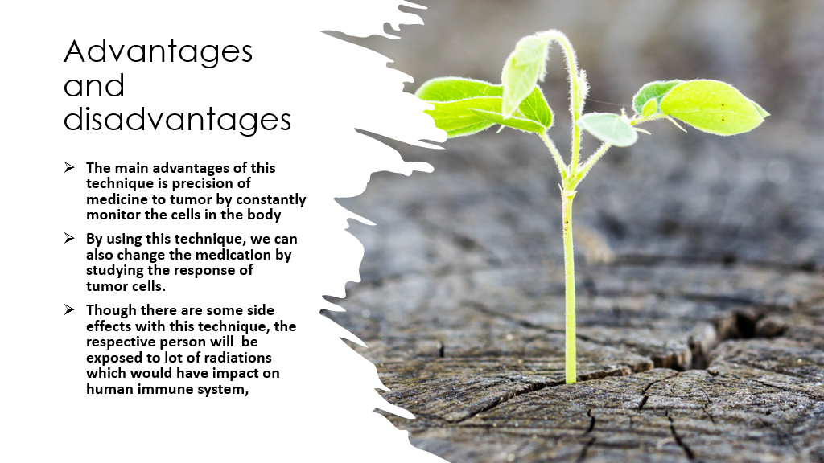

Slide 8
Why Build a classification model?
Brain tumor is a deadly disease that healthcare industry is facing.
Having a classification model which helps healthcare domain analyze if the patient has tumor and be able to predict it at early stages using machine learning model.
Conventional data such as MRI and lab results were used to train the model so as to predict if any new given image contains tumor or not.
Following traditional laboratory methods is time consuming, this is where Machine learning comes into picture. This model bridges the gap and ensures that the patient is treated at the earliest with results from the trained data.

Slide 9
Problem Solution
We are using machine learning to overcome tumor detection issues.
We are using deep learning techniques such as Convolution Neural Networks algorithm to build a model that can identify and detect tumor from the trained data.
Using this model Healthcare industry will be able to detect tumor within short span of time.
By detecting it in early stages, necessary precautions and treatments can be taken to cure the disease.
Using the images of the cured patient's tumor, we can train our model for higher accuracy and reduce risk factor. It will also help us estimate time required for treatment.

Slide 10
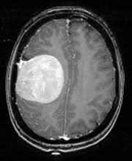
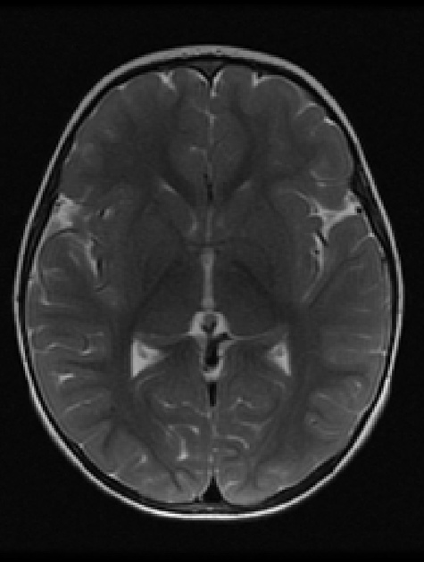
Dataset Description
Brain tumor images are extracted from Kaggle and Google Images to create a Dataset.
It contains both tumor and non-tumor images.
Dataset contains 2 folders with 253 images of Brain MRI images, which comprises of 155 tumor images and 98 non-tumor images.
2 folders are classified as YES and NO, where YES folder consists images with Tumor and NO folder with
Tumor and non-tumor images have a size of 240,240,3.

Slide 11
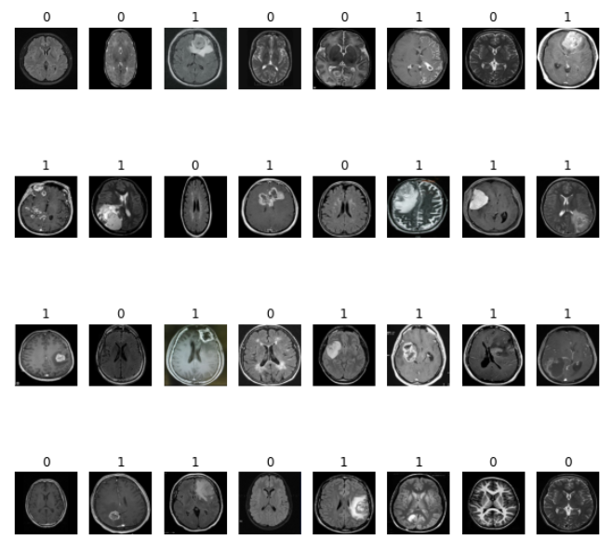
Binary Encoding of Brain Images

Slide 12
Introduction to CNN Architecture
CNN Architecture is basically used for computer vision problems such as Image classification, Image processing etc.
The Convolution Network consists of many building blocks including convolution layers, pool layers and completely incorporated layers and is designed to learn spatial hierarchies automatically and adaptively by means of a backpropagation algorithm.
For this problem we are using a deep learning classification model to predict a binary class (Yes or No).

Slide 13
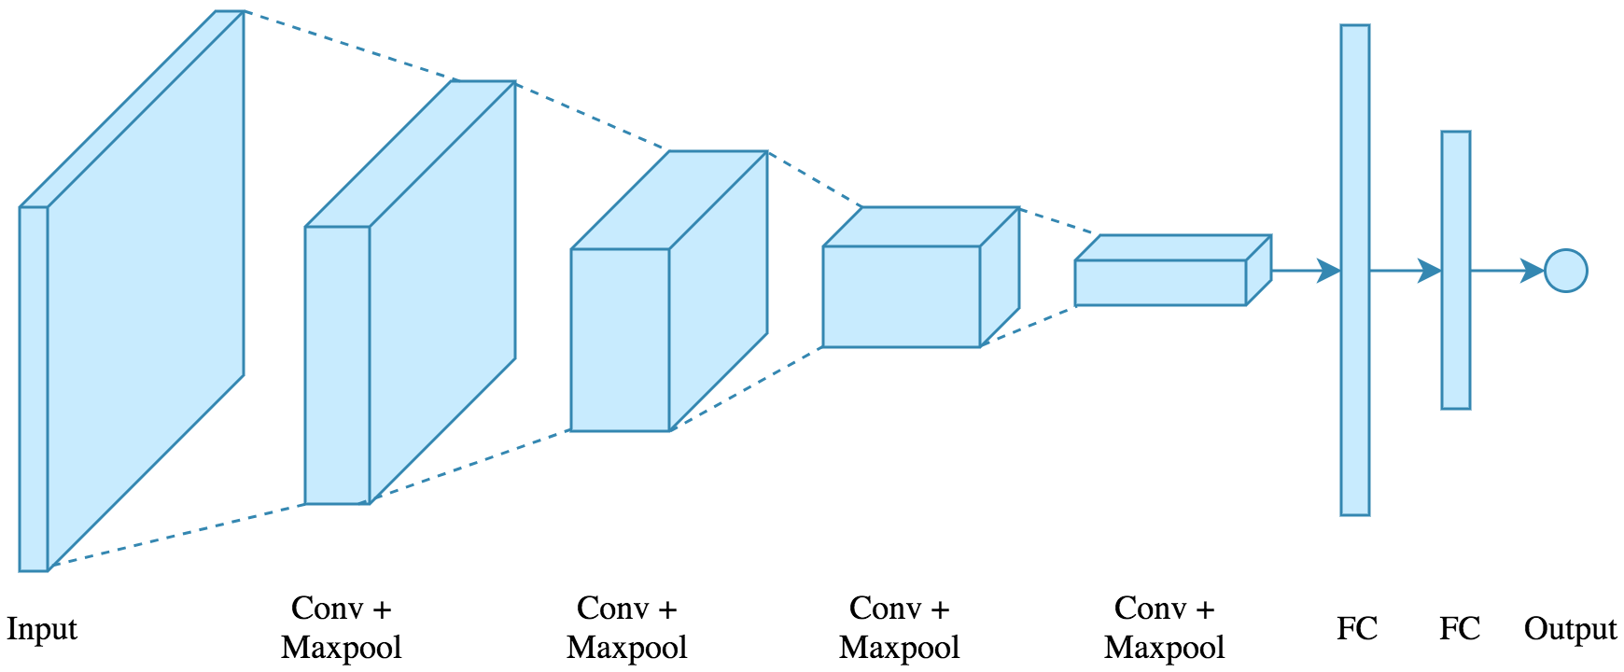
CNN Architecture
Reference: https://www.google.com/url?sa=i&url=https%3A%2F%2Ftowardsdatascience.com%2Fapplied-deep-learning-part-4-convolutional-neural-networks-584bc134c1e2&psig=AOvVaw1jEzHEB31j6GQAH-cclcJH&ust=1608489217031000&source=images&cd=vfe&ved=0CA0QjhxqFwoTCMDY1LnX2u0CFQAAAAAdAAAAABAD

Slide 14
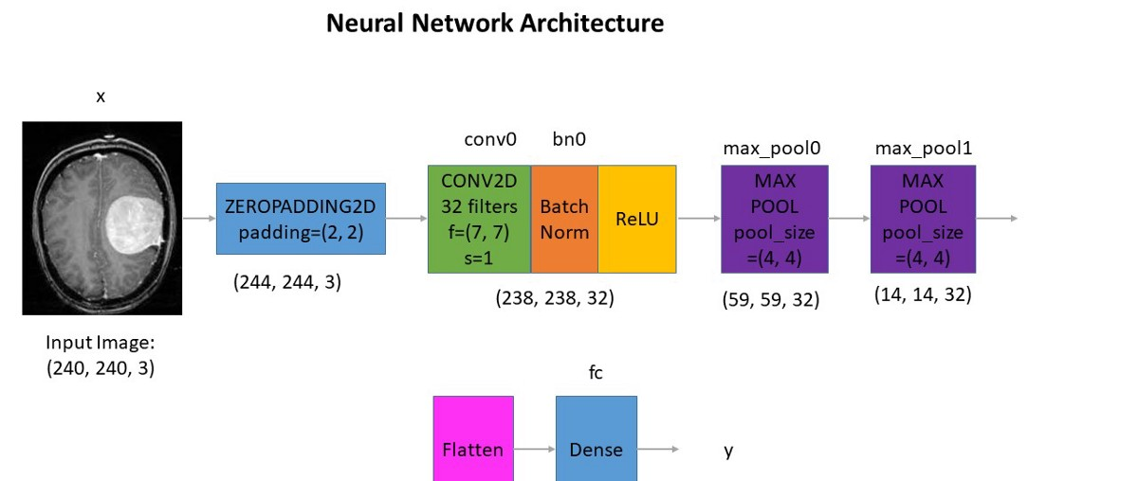
Applying CNN Algorithm to Predict Tumor
Reference: https://medium.com/@mohamedalihabib7/brain-tumor-detection-using-convolutional-neural-networks-30ccef6612b0

Slide 15
Steps to create a classification model
Data Preprocessing
Skull Striping
Data Augmentation
Train/Test Split
Building CNN model
Plotting of Accuracy
Classification of Test data using CNN model.

Slide 16
Data Preprocessing
Firstly, we have downloaded the data(images) from different sources based on our requirement.
Secondly, we have organized the images into two folders whether it has tumor or non-tumor(yes or no).
we have comprised all the images to a standard size(240*240)
.flow_from_directory() takes the folder directory path; we can also mention target size of 240,240. we mentioned class mode argument as binary because we have binary classification problem.
We have used image data generators to generate training dataset, testing and validation dataset based on data given and automatically assigns a label to data based on class.

Slide 17
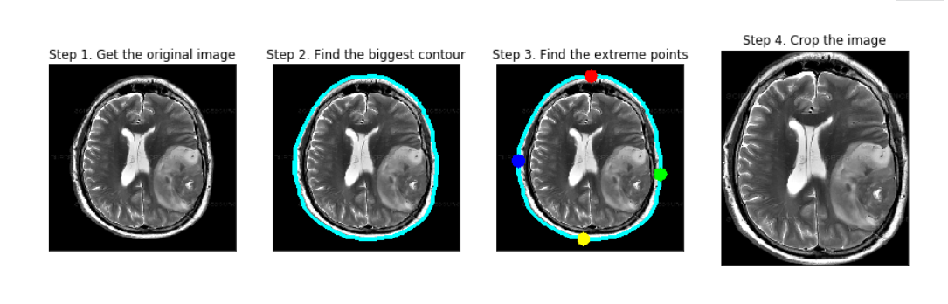
Skull Stripping
For this skull stripping we have used cropping technique to crop outer most skull which is insignificant for our model.
We have done that by considering big contour of all images which would prevent in loss of important information from image.
This technique mainly helps in studying the images in detail.
We have done this by using image processing library called open cv.
Reference:
https://medium.com/@sid321axn/brain-tumor-classification-using-deep-learning-5bbd8acef4b4

Slide 18
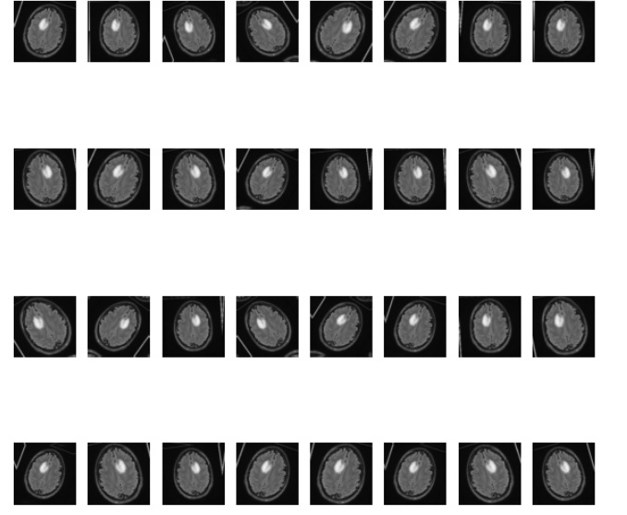
Data Augmentation
We have used data augmentation to generate excessive data by using the existing data with different variations.
Data augumation uses methods such as Randomflipping, RandomZoom, RandomShifting the image etc to generate the data.
By using data augumentation we have generated 980 non tumor images and 1085 tumor images.

Slide 19
Building the CNN model
We split the data into both training and testing dataset to train and validate the model in the ratio of 80:10:10.
We have used convolutional architecture to process the data by using normalization, convolutions(maxpooling and linear activation function) and classification model to classify the tumor.
we have used gradient descent method to update the weights based on loss function to increase the accuracy.
For this we have used Adam optimizer and Binary _CrossEntropy loss function and achieved an accuracy of 89%.

Slide 20
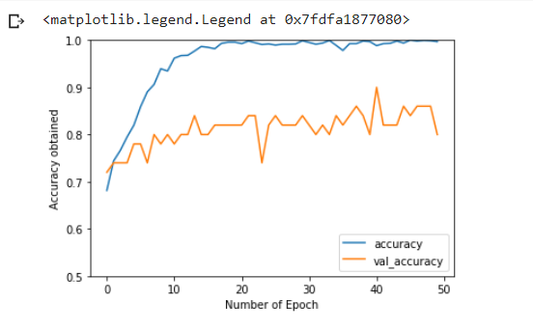
Plotting the accuracy
We have achieved an accuracy of 89% with validation dataset.
We have achieved a test accuracy of 96% which is most desirable.

Slide 21
Challenges
Since the problem is related to life and death small precision would cause a major difference.
Data authenticity(truthfulness) matters a lot since it is a sensible matter, you can’t address a patient with tumor as non tumor.
Since there are lot of techniques in market for detecting the tumor, this method has to be improved for more precision and should select some alternative methods to overcome side effects like radiations.

Slide 22
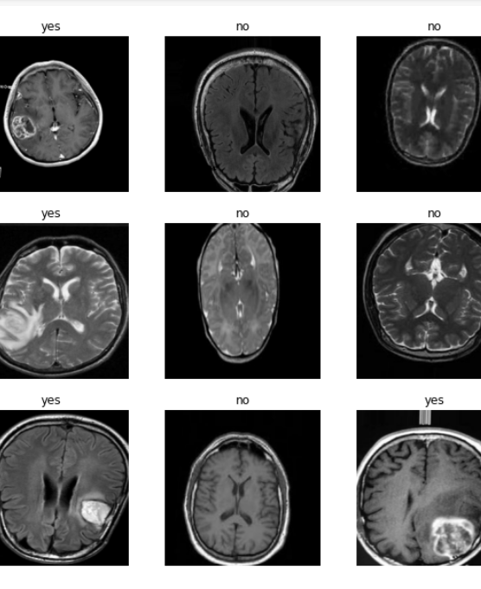
Conclusion
there is hope for life.

